Slide 1
NLP & Convolutional Neural Networks
W266: Natural Language Processing

Slide 2
Peeking ahead...
Week 1: Introduction
Week 2: Classification & Sentiment
Week 3: Convolutional Neural Networks (CNNs)
Week 4 - 5: Language Models
Week 6 - 7: Machine Translation
Week 8: Summarization
Week 9: Part-of-Speech Tagging
Week 10 - 11: Dependency Parsing, Constituency Parsing
Week 12: Information Retrieval
Week 13: Entities

Slide 3
Today’s plan...
“CNN? The news channel?” (10 min)
Sample CNN architecture & intuition
Literature & applications beyond NLP
Deconstructing CNNs (40 min)
Layers (Inputs, convolution layer, activation, pooling, FC layers, cost function)
Regularization (dropout)
Comments on additional topics (attention, jumping layers,...)
CNNs in NLP (40 min)
Common designs
NLP Applications (classification, translation,..)
Pros & Cons (comparison to other techniques)

Slide 4
“CNN? The News Channel?”
W266: Natural Language Processing

Slide 5
Last Week: Neural Bag of Words Model
Sigmoid Or Softmax
Issues:
Word ordering not preserved
No sense of larger context
….
There should be something better...:
CNNs (Today)
RNNs (Week 5)
Affine
Nonlinearity
Affine
Sum vectors
(“bag of words”)
+
e₁ e₂ e₃ e₄ e₅
w₁ w₂ w₃ w₄ w₅
Notes:
2-4 minute slide. Discuss network end-to-end starting with input word embeddings, summation to get sentence representation, feed through DNN layers and then used for softmax classification.

Slide 6
Why Not Just Standard FC NN for Images and Text?
Way too many parameters! Images:
Imagine 256 x 256 image in 3 colors, fully connecting to 256 x 256 x 12 dimensional output layer… how many parameters? (256 x 256 x 3) x (256 x 256 x 12) + (256 x 256 x 12) ~ 154 bn
Text:
Imagine you concatenate 30 words with 100-d embedding, fully connecting to a layer of same size… how many parameters? (30 x 100) x (30 x 100) + (30 x 100) ~ 9m
(weights)
(biases)
(weights)
(biases)
Notes:
Also, perhaps say 256 x 256 x 3 image is an input feature vector of length 196,608. As we know from A1, the weight matrix is [input x output] shaped, so even if we wanted to do a huge dimensionality reduction in the first layer from a ~200K input vector down to ~1000 output, how many parameters are in the weight matrix?
(Also, some commentary that we don't want to have to learn about a pattern separately when it occurs in each part of the image, that maybe we can do a better generalization by learning about a pattern and being able to apply it generally).
Another tie-in, which we may not have time except a passing reference is that in old-school image processing, humans would make their own "kernels" (filters). CNNs simply learn those kernels automatically.

Slide 7
Why Not Just Standard FC NN for Images and Text?
Way too many parameters! Images:
Imagine 256 x 256 image in 3 colors, fully connecting to 256 x 256 x 12 dimensional output layer… how many parameters? (256 x 256 x 3) x (256 x 256 x 12) + (256 x 256 x 12) ~ 154 bn
Text:
Imagine you concatenate 30 words with 100-d embedding, fully connecting to a layer of same size… how many parameters? (30 x 100) x (30 x 100) + (30 x 100) ~ 9m
Completely unworkable
(weights)
(biases)
(weights)
(biases)
Notes:
Way too expensive, overfitting like nutso, and probably very poor training.

Slide 8
That’s Why: Convolutional Neural Nets (CNNs)
Greatly reducing parameters! Critical Observations:
Many features are ‘local’, i.e., one needs to inspect only small neighborhood to detect
Often, it does not matter where an object or a word is (“I just care that there is a bird, not where it is”)
Core Idea: “Slide small window across image/text and that looks for features locally and that connects neuron of input with neurons of output layer.”
Neurons in output layer only ‘see’ small neighborhood
The same parameters are used across image/text. MUCH cheaper!
Notes:
But this is just the surface!

Slide 9

Broad Usage of CNNs in Current Research
Many publications using CNNs! Some topics of papers on arXiv.org using CNNs... in September ‘2018 (~ 75 papers!):
Image Analysis
NLP
Algorithms
Healthcare
Traffic and Pollution Forecasting
Social Studies
Theoretical Computer Science
Material Science
...
(This one isn’t about ‘our’ CNNs, but uses CNN dataset)
Notes:
But this is just the surface!

Slide 10
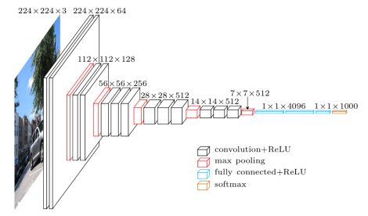
A Classic CNN Architecture in Computer Vision: VGG16
Oxford University’s ‘Visual Geometry Group’, Simonyan & Zisserman, 2014 see: “Very Deep Convolutional Networks for Large-Scale Image Recognition”, https://arxiv.org/pdf/1409.1556.pdf
Immediate Observations?
Image Source: https://www.cs.toronto.edu/~frossard/post/vgg16/
Notes:
But this is just the surface!

Slide 11
A Classic CNN Architecture in Computer Vision: VGG16
Oxford University’s ‘Visual Geometry Group’, Simonyan & Zisserman, 2014 see: “Very Deep Convolutional Networks for Large-Scale Image Recognition”, https://arxiv.org/pdf/1409.1556.pdf
Immediate Observations?
“Many” Layers (deep)
Different types of layers (convolutional, pooling)
“Thickness” of layers
“Squeezing”
Image Source: https://www.cs.toronto.edu/~frossard/post/vgg16/
Notes:
But this is just the surface!

Slide 12
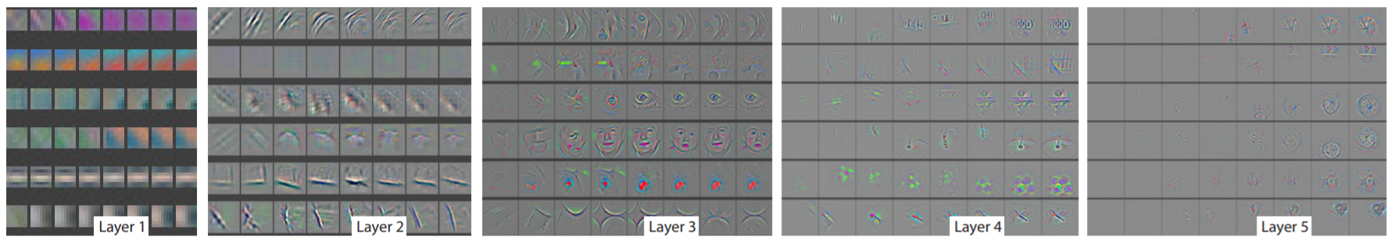
Learning
Early layers learn concrete features (edges, etc.)
Deeper layers learn more abstract features
Source: “Visualizing and Understanding Convolutional Neural Networks”, Zeiler & Fergus, NYU https://arxiv.org/pdf/1311.2901.pdf
Notes:
But this is just the surface!

Slide 13
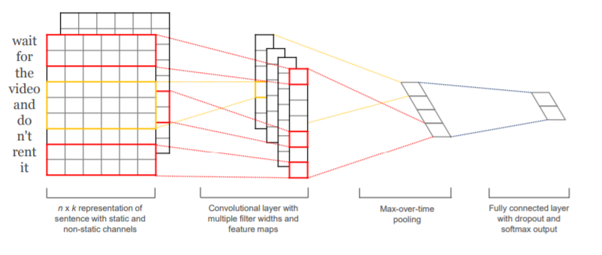
What About NLP & CNNs?
Intuition: Similar idea*!
“From individual features (words) to text segments to ‘meaning’”
Source: “Convolutional Neural Networks for Sentence Classification”,Kim, NYU https://arxiv.org/pdf/1408.5882.pdf
*Location invariance? Not ideal in general for language (RNNs are more suited in that regard)
Notes:
But this is just the surface!

Slide 14
Deconstructing CNNs (Sample Case: Vision)
W266: Natural Language Processing

Slide 15
Layers: Convolutional Layer
Assume you want to build an “Edge Detector” for an image… what matters?
Observations:
“Edge” is a local concept, i.e., only need to look at small neighborhood
“An edge is an edge”, wherever it is in image, i.e. translational symmetry
Simple Example: 1D
Original “Image”
Goal: Detected Edges
Notes:
But this is just the surface!

Slide 16
Layers: Convolutional Layer (plus Activation)
Idea: slide window across image
Convert to numbers
0 | 0 | 0 | 1 | 1 | 1 | 0 | 0 | 1 | 1 | 1 | 1 | 0 | 0
x
x
x
? | ? | ?
+
? | ? | ? | ? | ? | ? | ? | ? | ? | ? | ? | ?
Apply non-linearity (RELU)
0 | 0 | 1 | 0 | 1 | 0 | 0 | 1 | 0 | 0 | 1 | 0
Notes:
But this is just the surface!

Slide 17
Layers: Convolutional Layer (plus Activation)
Idea: slide window across image
Convert to numbers
0 | 0 | 0 | 1 | 1 | 1 | 0 | 0 | 1 | 1 | 1 | 1 | 0 | 0
x
x
x
-1 | 2 | -1
+
0 | ? | ? | ? | ? | ? | ? | ? | ? | ? | ? | ?
Apply non-linearity (RELU)
0 | ? | ? | ? | ? | ? | ? | ? | ? | ? | ? | ?
Notes:
But this is just the surface!

Slide 18
Layers: Convolutional Layer (plus Activation)
Idea: slide window across image
Convert to numbers
0 | 0 | 0 | 1 | 1 | 1 | 0 | 0 | 1 | 1 | 1 | 1 | 0 | 0
x
x
x
-1 | 2 | -1
+
0 | -1 | 1 | 0 | 1 | ? | ? | ? | ? | ? | ? | ?
Apply non-linearity (RELU)
0 | 0 | 1 | 0 | 1 | ? | ? | ? | ? | ? | ? | ?
Notes:
But this is just the surface!

Slide 19
Layers: Convolutional Layer (plus Activation)
Idea: slide window across image
Convert to numbers
0 | 0 | 0 | 1 | 1 | 1 | 0 | 0 | 1 | 1 | 1 | 1 | 0 | 0
x
x
x
-1 | 2 | -1
+
0 | -1 | 1 | 0 | 1 | 0 | -1 | 1 | 0 | 0 | 1 | -1
Apply non-linearity (RELU)
0 | 0 | 1 | 0 | 1 | 0 | 0 | 1 | 0 | 0 | 1 | 0
Notes:
But this is just the surface!

Slide 20
Layers: Convolutional Layer
Side Question: “Why not simple window of length 2?”
0 | 0 | 0 | 1 | 1 | 1 | 0 | 0 | 1 | 1 | 1 | 1 | 0 | 0
1 | -1
Notes:
But this is just the surface!

Slide 21
Layers: Convolutional Layer
Side Question: “Why not simple window of length 2?”
0 | 0 | 0 | 1 | 1 | 1 | 0 | 0 | 1 | 1 | 1 | 1 | 0 | 0
1 | -1
0 | 0 | -1 | 0 | 0 | 1 | 0 | -1 | 0 | 0 | 0 | 1 | 0
Notes:
But this is just the surface!

Slide 22
Layers: Convolutional Layer
Side Question: “Why not simple window of length 2?”
0 | 0 | 0 | 1 | 1 | 1 | 0 | 0 | 1 | 1 | 1 | 1 | 0 | 0
1 | -1
0 | 0 | -1 | 0 | 0 | 1 | 0 | -1 | 0 | 0 | 0 | 1 | 0
Won’t survive non-linearity (activation)!
Notes:
But this is just the surface!

Slide 23
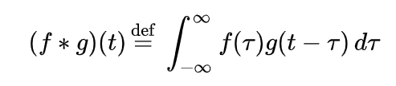
Layers: Convolutional Layer - Comments
Wikipedia Definition of Convolution: That’s very similar to what we did!
g: ‘image’ (digitized)
f: ‘flipped’ window with weights
t: ‘step’ in image
tau: position of neighbor to consider relative to step
Integral: sum in our case
Why not an infinite sum for us? Choose ‘f = 0’ outside of window then it looks like it..
Notes:
But this is just the surface!

Slide 24
Layers: Convolutional Layer - Comments
Interpretation in Neural Net language:
Not fully-connected!
Each output neuron only sees small number of input neurons. (Term: ‘Receptive Field’)
Parameter-sharing
Wherever you are in image, the weights are the same (for the same convolution)
Stride size: step size between window-evals (here: 1)
Padding: do you want to pad input with zeros, so that you can start at 1st point preserving size? That’s yet a(nother) hyper-parameter
Notes:
But this is just the surface!

Slide 25
Layers: Convolutional Layer - Comments
Why do Convolutional Layers can have ‘thickness’?:
Introduce more filters to look for more features!
0 | 0 | 0 | 1 | 1 | 1 | 0 | 0 | 1 | 1 | 1 | 1 | 0 | 0
W_{A1} | W_{A2} | W_{A3}
“Search for vertical edges...”
W_{B1} | W_{B2} | W_{B3}
“Search for horizontal edges ….”
W_{C1} | W_{C2} | W_{C3}
“Search for ...”
Resulting layer has ‘thickness’!
0 | 0 | 0 | 1 | 1 | 1 | 0 | 0 | 1 | 1 | 1 | 1 | 0 | 0
0 | 0 | 0 | 1 | 1 | 0 | 0 | 0 | 1 | 1 | 1 | 1 | 0 | 0
0 | 0 | 0 | 1 | 0 | 1 | 0 | 0 | 1 | 1 | 1 | 1 | 0 | 0
Notes:
But this is just the surface!

Slide 26
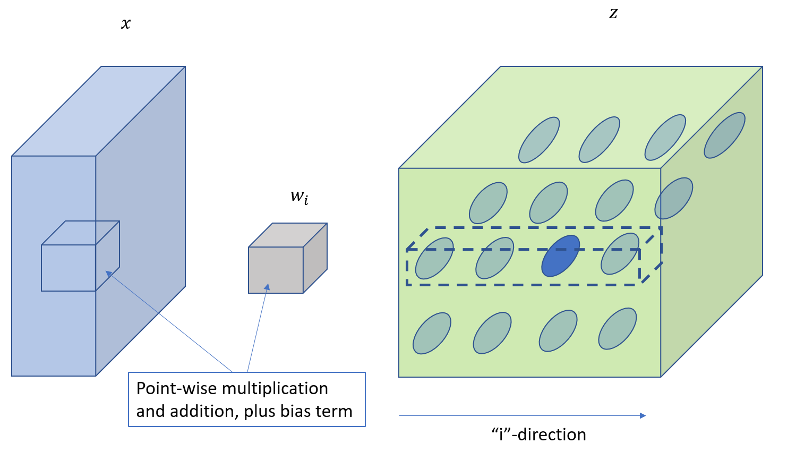
Layers: Convolutional Layer - Dimensions
Geez… how does that work out for next layer? Which neuron talks to which, if input and output are multi-dimensional?
Good discussion in: http://cs231n.github.io/convolutional-networks/
Output Layer
Input Layer
Receptive Field for all neurons in dashed box:
Target neurons ‘see’ full depth of input layer neurons within window
Each target neuron in dashed box has different weight/bias filter.
Each target layer neuron in same plane uses same weight/bias
3D weights for output dim ‘i’
Notes:
But this is just the surface!

Slide 27
Layers: Convolutional Layer - Dimensions
Exercise:
Input Layer has: 256 x 256 x 3 dimensions
Filter Dimensions: 3 x 3
Output layer: 256 x 256 x 12 dimensions
…. How many weight and bias parameters?
Notes:
But this is just the surface!

Slide 28
Layers: Convolutional Layer - Dimensions
Breakout Room (5 min)
Notes:
But this is just the surface!

Slide 29
Layers: Convolutional Layer - Dimensions
Exercise:
Input Layer has: 256 x 256 x 3 dimensions
Filter Dimensions: 3 x 3
Output layer: 256 x 256 x 12 dimensions
…. How many weight and bias parameters? (3 x 3 x 3 + 1) x 12 = 336 …… a lot better than what we had on slide 6!
Notes:
But this is just the surface!

Slide 30
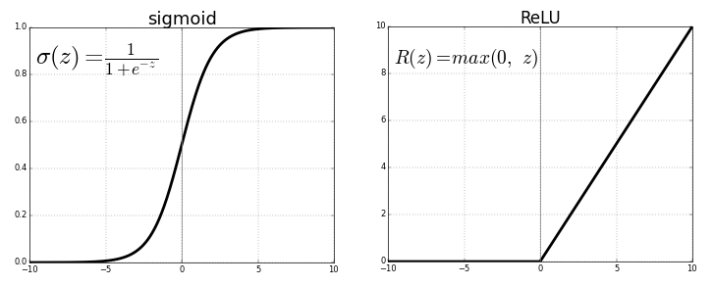
Layers: Activations
Weak training input due to small gradient. (Back-propagation picks up product of derivatives through chain-rule…)
ReLU (very common) vs. Sigmoid:
Image Source: https://towardsdatascience.com/activation-functions-neural-networks-1cbd9f8d91d6
Notes:
But this is just the surface!

Slide 31
Layers: Pooling Layer
Parameter-sharing is good. Pooling helps on top of that, reducing work and overfitting. Example:
Max-Pooling:
3 | 6 | 2 | 5
4 | 0 | 6 | 7
7 | 3 | 1 | 3
9 | 2 | 1 | 3
Hyper-parameters:
Window dimension
Stride size
Trainable Parameters:
Zero
6 | 7
9 | 3
Which stride size is applied?
Notes:
But this is just the surface!

Slide 32
Layers: Fully Connected Layers & Classification
How to transition to 1D Classifier?
Fully Connected Layers:
Connect each neuron of last conv layer with 1D layer
Use multiple layers
Classify:
Apply softmax instead of activation on last layer
Use appropriate cost function to train and classify
Notes:
Input n*n image, convolve with f*f filter ⇒ output shape = (n-f+1) * (n-f+1)
if p = padding amount (width of padded border) → output shape = (n+2p-f+1) * (n+2p-f+1)
if input image n*n, filter size f*f, padding = f, stride = s ⇒ output shape = (floor((n+2p-f)/s) + 1) * (floor((n+2p-f)/s) + 1)

Slide 33
Regularization: Dropout
Still a ton of parameters. Regularization, anyone?
Dropout is a good option (regular regularization works too..)
‘Invented’ by Geoff Hinton and team (U. Toronto), 2012 (https://arxiv.org/pdf/1207.0580.pdf)
What it does:
Randomly drop a fraction of activations during training. Don’t do that during evaluation(!)
Ensures that more robust features are learned
Yet another hyper-parameter:
Dropout rate
Notes:
But this is just the surface!

Slide 34
CNN Hyperparameters
Collecting an (incomplete) set of key hyper-‘parameters’:
Number of layers
Types of layers
Shape of layers (3D in our example!)
Padding approach
Filter dimensions
Step sizes
Pooling approach
Dropout rate
Optimizer…
…
…..lots to try!
Notes:
But this is just the surface!

Slide 35
VGG16: Fully Understood!
… A Question: “Why are red layers thinner than following black layers?”
Notes:
But this is just the surface!

Slide 36
Finally: CNNs in NLP
W266: Natural Language Processing

Slide 37
Sentence Classification with CNNs
Kim (NYU, 2014, http://www.aclweb.org/anthology/D14-1181 ) (depicting slightly more complicated ‘multi-channel’ architecture*)
* Two channels: one is standard word2vec, the other set is re-trained. Results are added in filters.
Notes:
But this is just the surface!

Slide 38
Sentence Classification with CNNs
Kim (NYU, 2014, http://www.aclweb.org/anthology/D14-1181 ) Basic Logic (simple!):
Consider Source Sentence: [‘I’, ’am’, ’very’, ‘happy’, ’today’]
Notes:
But this is just the surface!

Slide 39
Sentence Classification with CNNs
Kim (NYU, 2014, http://www.aclweb.org/anthology/D14-1181 ) Basic Logic (simple!):
Consider Source Sentence: [‘I’, ’am’, ’very’, ‘happy’, ’today’]
Use embedding: [x₁, x₂ , x₃ , x₄ , x₅] (dim: n x H (H: embed dim))
Notes:
But this is just the surface!

Slide 40
Sentence Classification with CNNs
Kim (NYU, 2014, http://www.aclweb.org/anthology/D14-1181 ) Basic Logic (simple!):
Consider Source Sentence: [‘I’, ’am’, ’very’, ‘happy’, ’today’]
Use embedding: [x₁, x₂ , x₃ , x₄ , x₅] (dim: n x H (embed D))
Filter by ‘windowing’ over k consecutive word vectors and, at each step i:
Concatenate the k vectors to get one vector Z_{i} (dim: k * H)
Apply affine transformation and non-linearity to get feature vectors c_{i} : c_{i} = f (W Z_{i} + b)
Notes:
But this is just the surface!

Slide 41
Sentence Classification with CNNs
Kim (NYU, 2014, http://www.aclweb.org/anthology/D14-1181 ) Basic Logic (simple!):
Consider Source Sentence: [‘I’, ’am’, ’very’, ‘happy’, ’today’]
Use embedding: [x₁, x₂ , x₃ , x₄ , x₅] (dim: n x H (embed D))
Filter by ‘windowing’ over k consecutive word vectors and, at each step i:
Concatenate the k vectors to get one vector Z_{i} (dim: k * H)
Apply affine transformation and non-linearity to get feature vectors c_{i} : c_{i} = f (W Z_{i} + b)
4) Get the max of all c_{i} to get hat(c) … the feature corresponding to this filter
Notes:
But this is just the surface!

Slide 42
Sentence Classification with CNNs
Kim (NYU, 2014, http://www.aclweb.org/anthology/D14-1181 ) Basic Logic (simple!):
Consider Source Sentence: [‘I’, ’am’, ’very’, ‘happy’, ’today’]
Use embedding: [x₁, x₂ , x₃ , x₄ , x₅] (dim: n x H (embed D))
Filter by ‘windowing’ over k consecutive word vectors and, at each step i:
Concatenate the k vectors to get one vector Z_{i} (dim: k * H)
Apply affine transformation and non-linearity to get feature vectors c_{i} : c_{i} = f (W Z_{i} + b)
4) Get the max of all c_{i} to get hat(c) … the feature corresponding to this filter
5) Do this for multiple filters
Notes:
But this is just the surface!

Slide 43
Sentence Classification with CNNs
Kim (NYU, 2014, http://www.aclweb.org/anthology/D14-1181 ) Basic Logic (simple!):
Consider Source Sentence: [‘I’, ’am’, ’very’, ‘happy’, ’today’]
Use embedding: [x₁, x₂ , x₃ , x₄ , x₅] (dim: n x H (embed D))
Filter by ‘windowing’ over k consecutive word vectors and, at each step i:
Concatenate the k vectors to get one vector Z_{i} (dim: k * H)
Apply affine transformation and non-linearity to get feature vectors c_{i} : c_{i} = f (W Z_{i} + b)
4) Get the max of all c_{i} to get hat(c) … the feature corresponding to this filter
5) Do this for multiple filters
6) Add a standard fully connected layer for classification
Notes:
But this is just the surface!

Slide 44
Sentence Classification with CNNs: Calc Example
Assume first filter: W¹ = (1,3,-1,2,1,-1)
b¹ = 3 k¹ = 3
f: tanh
H = 2
-3 -2 3 4 -1
-5 2 1 3 -1
Filter selects features (weights & bias are learned)
I am very happy today
Notes:
But this is just the surface!

Slide 45
Sentence Classification with CNNs: Calc Example
Assume first filter: W¹ = (1,3,-1,2,1,-1)
b¹ = 3 k¹ = 3
f: tanh
H = 2
-3 -2 3 4 -1
-5 2 1 3 -1
-3
-5
-2
2
3
1
c₂ = f (W¹ + b¹) = f (-8 + 3) ~ -0.99
I am very happy today
Notes:
But this is just the surface!

Slide 46
Sentence Classification with CNNs: Calc Example
Assume first filter: W¹ = (1,3,-1,2,1,-1)
b¹ = 3 k¹ = 3
f: tanh
H = 2
-3 -2 3 4 -1
-5 2 1 3 -1
-2
2
3
1
4
3
c₃ = f (W¹ + b¹) = f ( 2 + 3) ~ 0.99
I am very happy today
Notes:
But this is just the surface!

Slide 47
Sentence Classification with CNNs: Calc Example
Assume first filter: W¹ = (1,3,-1,2,1,-1)
b¹ = 3 k¹ = 3
f: tanh
H = 2
-3 -2 3 4 -1
-5 2 1 3 -1
c¹ = (..., -0.99, 0.99,..) max(c¹) = 0.99
“Yup! Feature detected!”
I am very happy today
Notes:
But this is just the surface!

Slide 48
Sentence Classification with CNNs: Calc Example
Assume first filter: W¹ = (1,3,-1,2,1,-1)
b¹ = 3 k¹ = 3
f: tanh
H = 2
-3 -2 3 4 -1
-5 2 1 3 -1
Side Question:
“Is varying sentence-length a problem here?”
c¹ = (..., -0.99, 0.99,..) max(c¹) = 0.99
I am very happy today
Notes:
But this is just the surface!

Slide 49
Sentence Classification with CNNs: Calc Example
Assume first filter: W¹ = (1,3,-1,2,1,-1)
b¹ = 3 k¹ = 3
f: tanh
H = 2
-3 -2 3 4 -1
-5 2 1 3 -1
Side Question:
“Is varying sentence-length a problem here?”
Answer:
“Not here… max() takes care of that.” (Note: In many other situations we would pad to ensure equal length.)
c¹ = (..., -0.99, 0.99,..) max(c¹) = 0.99
I am very happy today
Notes:
But this is just the surface!

Slide 50
Sentence Classification with CNNs: Calc Example
Apply many filters, different W,b, k…. Each one provides a ‘max(c)’:
-3 -2 3 4 -1
-5 2 1 3 -1
C = ( 0.99, 0.73, -0.3 ,....... )
max(c¹)
max(c³)
I am very happy today
Notes:
But this is just the surface!

Slide 51
Sentence Classification with CNNs: Calc Example
Apply many filters, different W,b, k….
-3 -2 3 4 -1
-5 2 1 3 -1
Just a vector…, can be used as input for standard FC and softmax classification!
C = ( 0.99, 0.73, -0.3 ,....... )
I am very happy today
Notes:
But this is just the surface!

Slide 52
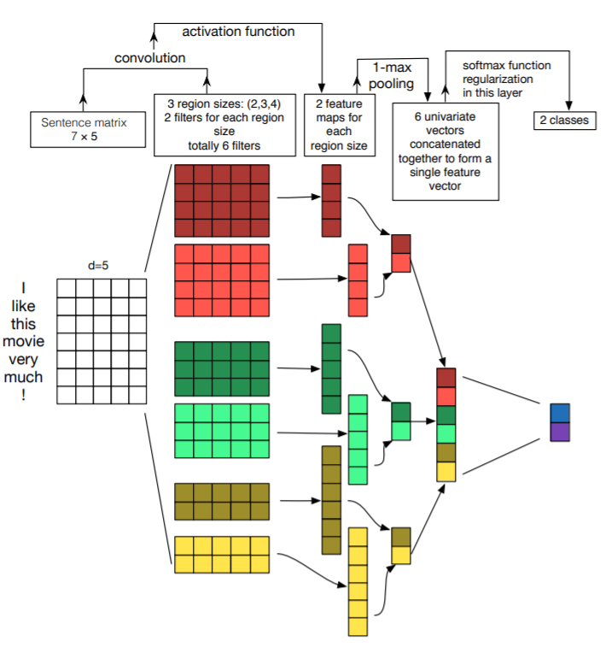
Sentence Classification with CNNs
Another View: Zhang/Wallace (UT Austin, 2014, https://arxiv.org/pdf/1510.03820.pdf )
Discussion:
Same as previous work?
Why have feature maps varying length?
...
Notes:
But this is just the surface!

Slide 53
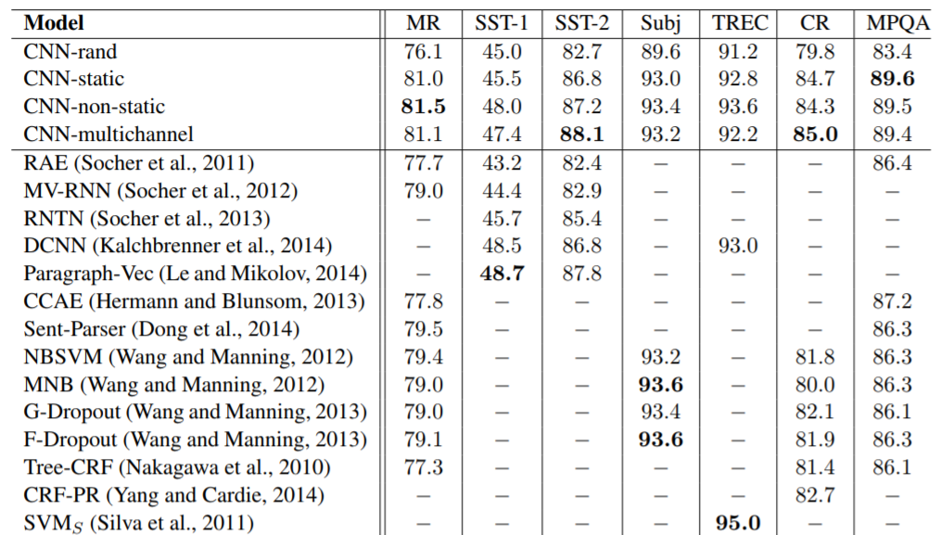
Very Good Results!
Self-trained embeddings.. Not good! (Only ~ 10k sentences in sets...)
Word2vec pre-trained embeddings
Initialized with Word2vec pre-trained embeddings, then trained further
Combination of fixed and trainable word2vec embeddings
Kim (NYU, 2014, http://www.aclweb.org/anthology/D14-1181 )
Notes:
We had lots of discussions in class about word embeddings...

Slide 54
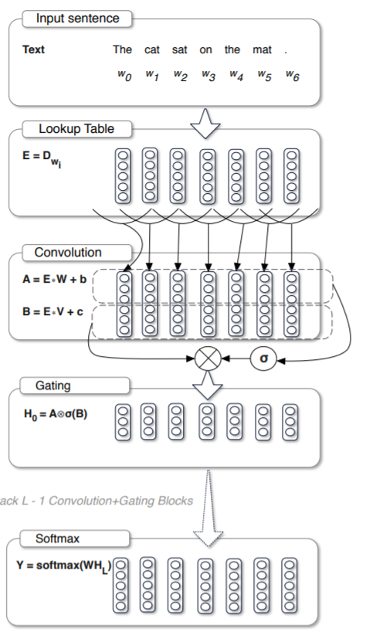
Other NLP Applications & Design Aspects
Language Models: “Language Modeling with Gated Convolutional Networks” (Dauphin et al, Facebook AI Research, 2016, https://arxiv.org/pdf/1612.08083.pdf )
Alternative to RNNs for language models (next week!)
10x faster than RNN with similar scores (in some settings)
But… part of the architecture is pretty much what we just did!
New concept though: “Gated Linear Unit” (inspired by RNNs)
Output = (E W + b) * sigma(E V + c)
Question: “How does that differ from what we did before?”
Notes:
Lots to discuss… let’s revisit after we cover LMs
Very similar to what we did...
Word embeddings (as always)
Sliding window across finite word vectors (effectively same filter size for all filters in the previous approach)
Affine transformation on concatenated word vectors
New is activation, the gating part, and the output (“Gated Linear Units”)
Inspired by RNN structure (which we will discuss later)

Slide 55
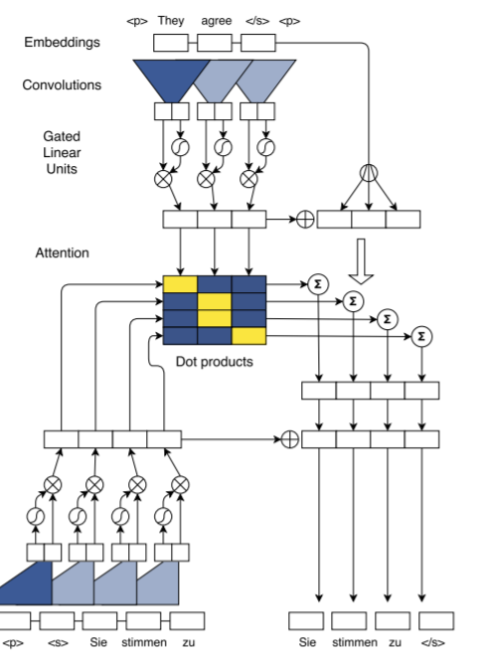
Other NLP Applications & Design Aspects
Translation: “Convolutional Sequence-to-Sequence Learning” (Gehring at al, Facebook AI Research, 2017, https://arxiv.org/pdf/1705.03122.pdf )
Alternative to RNNs for translation models (later!)
10x faster than RNN with excellent scores
Lots to discuss… let’s revisit after we cover Translations..
But… again… part of the architecture is pretty much what we just did!
Word embeddings (as always)
Sliding window across finite word vectors
“Gated Linear Units” of previous article are used
Notes:
But this is just the surface!

Slide 56
That’s it for today!
W266: Natural Language Processing

